Slide 1
Benchmark Framework
Copyright © 2015 ADP, LLC. Proprietary and Confidential.

Slide 2
Benchmark Framework
Reusable component to generate cubes/rollups or aggregations
Fast and Scalable computation using Apache Spark.
Developed in Scala.
Less than 250 lines of “Core” Cubing Logic code.
Generate Benchmarks using Configuration – NOT code.
Pluggable Sources and Sinks
Easily extensible.
Simple Upgrade Path to Spark 1.6 and Spark 2.0 (to leverage new features)

Slide 3
Architecture
Sources
Sinks
Hive Tables
Hive Tables
Benchmark Factory
In-Progress**
Cube Configuration

Slide 4
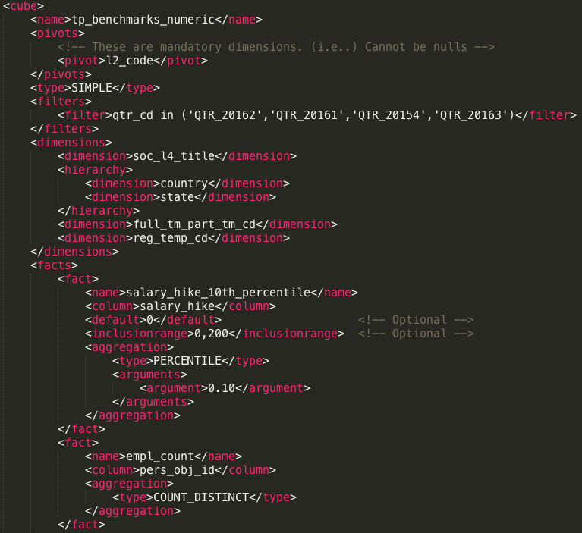
Configuration Driven Cubing
Cube Name
Pivots are Non Empty Dimensions
Dimensions.
Standalone/Hierarchical
Fact Definition
Column Name
Optional defaults & ranges
Aggregation
Method & Arguments

Slide 5
Features
Aggregations Supported
SUM, AVG, MAX, MIN, COUNT, COUNT_DISTINCT, APPROX_COUNT_DISTINCT, NUM_MISSING, NUM_NON_MISSING, PERCENTILE, PERCENTILE_ROUNDED etc…
Future extensions ... Rolling Aggregations.
Advanced Multi-level Aggregations
Whats the average turnover rate noticed in clients in a given industry?
Whats the median regular employee percentage in clients in a state?
First level “Percentage of Regular Employees”
Second level “Median”

Slide 6
Features
Support for advanced types of dimensions
Simple Standalone dimensions
Tenure Band
Range Band etc..
Hierarchical Dimensions
Doesn't compute unnecessary combinations which do not occur in cube.
Reduces the number of distinct combinations in cube – on the fly. Eg,
Year (2) >> Quarter (4) >> Month (12) >> Week (104 )
104 keys instead of 9984 along this dimension.
NAICS 2 >> NAICS 4 >> NAICS 6
Country >> State

Slide 7
Features
Highly customizable filters for computing facts
Exclude known outliers
<inclusionrange>0,200</inclusionrange>
Specify Defaults
<default>REGULAR</default>
Exclude Zeros
<excludezeros>true</excludezeros>
Advanced column filters
<expr>CASE WHEN bonus_ &gt; 10 THEN bonus_ ELSE NULL END</expr>

Slide 8
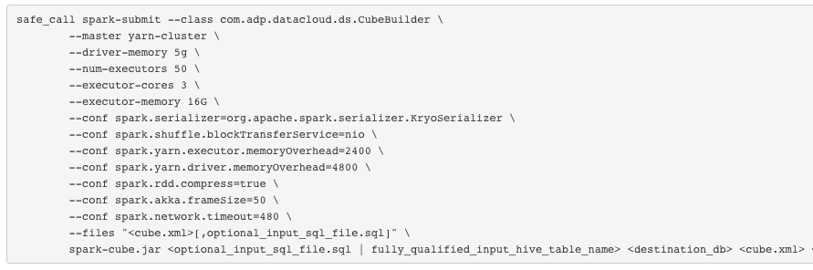
How to use
Source
Sink
Config

Slide 9
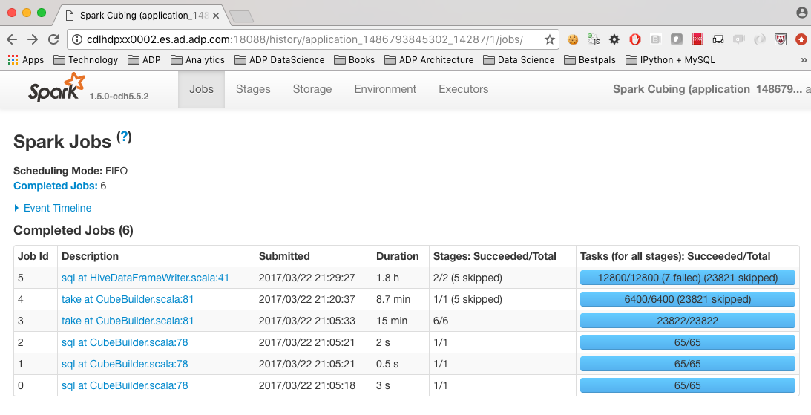
How fast?
Quarterly Benchmark Cube
8 Dimensions
13 Aggregations
(No percentiles)
Input Size = 57M
Cube Size = 111M
Time Taken = 2 Hr 15 Min
https://bitbucket.es.ad.adp.com/projects/DSCOMMON/repos/spark-utils/browse/spark-cube/src/test/resources/quarterly_cube.xml

Slide 10
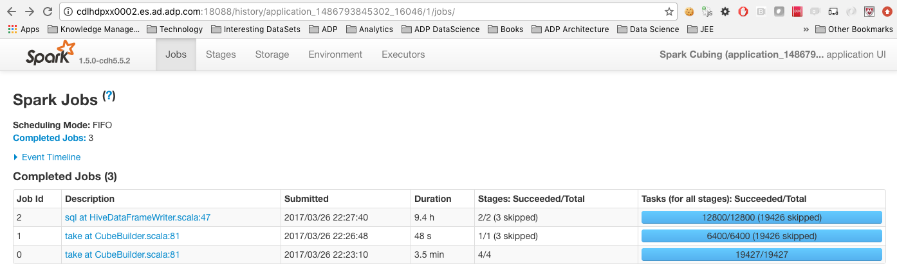
How fast?
Annual Benchmark Cube
8 Dimensions
8 Facts (5 percentiles for each)
Percentiles Aggregations
Input Size = 57M
Cube Size = 78M
Time Taken = 9 Hr 30 Min
https://bitbucket.es.ad.adp.com/projects/DSCOMMON/repos/spark-utils/browse/spark-cube/src/test/resources/annual_cube_hive_percentiles.xml

Slide 11
Aggregations Supported
Basic
SUM, MIN, MAX, COUNT, COUNT_DISTINCT, PERCENT, NUM_MISSING, NUM_NON_MISSING
Advanced
PERCENTILE
ROUNDED_PERCENTILE (alternate form to return percentiles rounded to the nearest multiple)
PERCENTILE_OF_PERCENTAGES
COUNT_DISTINCT_PARTITIONED
More to come in the future…
Window functions. Eg, Rolling Averages etc…

Slide 12
Ideas & Contributions are not only welcome, but also most appreciated…
https://bitbucket.es.ad.adp.com/projects/DSCOMMON/repos/spark-utils/browse/spark-cube

